Slide 1
Implementation of the artifact removal coding
Yupeng Tian
2019 Nov 7

Slide 2
Introduction
This presentation introduces our DBS artifact removal algorithms.
The code has 7 outputs (Figure 1~7). All units of the x-axis are m-sec.
In line 9 choose Nor =0 if you don’t want normalized output but want the original scale.
It consists of 4 steps:
1. Import the original signal.
2. Organize the data. (A). Find the maximums in artifacts and divide the signal into individual trials. (B). Select the segment “starting from its minimum to end” for each individual trial.
3. Select the artifact part of each trial. Fit spline to the mean trials to find the trend.
4. Use the spline fit and do adaptive filtering to each individual trial to find the artifact.

Slide 3
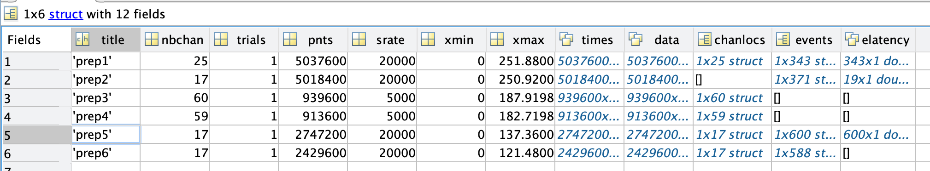
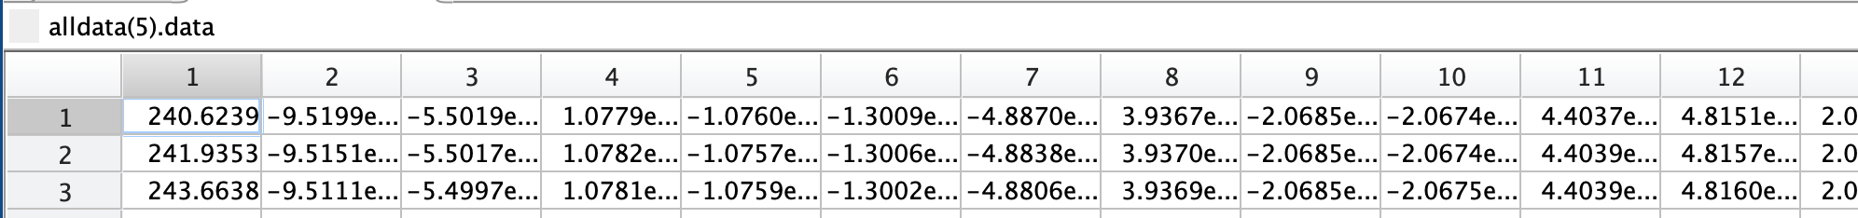
Step 1: Import the original signal
In line 3 of the mfile, put in row number that represents the data set we are considering. E.g. inp=5.
In line 6, put in the column number that represents the channel in the selected date set.
E.g., in the 5th data set we have 17 columns (channels) and we pick the 1st: inq_col = 1

Slide 4
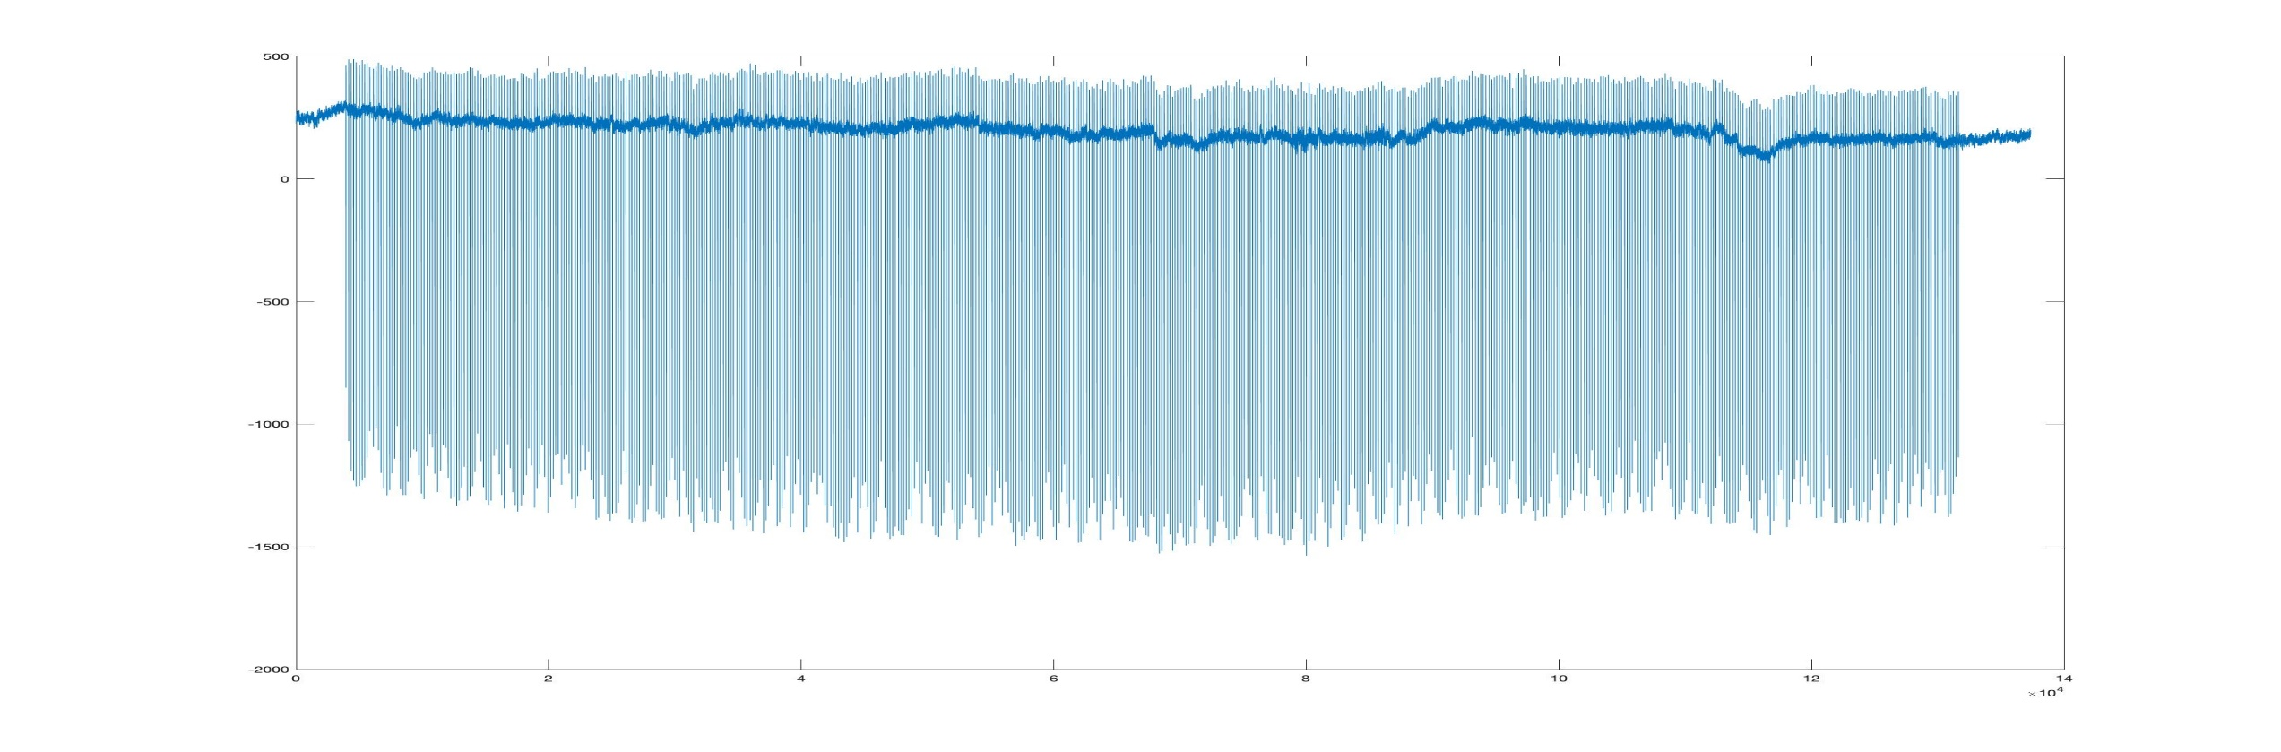
Step 1: Import the original signal
The following (output Figure 1 of the program) is the 1st channel of the 5th data set. All the following examples are based on this channel. Total length is about 135s = 1.35e5 ms.

Slide 5
Step 2: Organize the data
(1). Find the maximums in artifacts and divide the signal into individual trials.
In line 22, put in the part of the channel that you want to consider. For example,
In the above example, we use dt=0.05ms, so part length = (250e3 - 35e3)*dt = 10.75s.
Then the program does the following: (1) Subtract the mean to make the part “0 mean”; (2) Find the indices of the maximums in the artifact pulses; (3) Starting from each index in (2), select a segment of length L_sel_ms = 200ms “starting from 1ms to the left of the index”. Thus will make the shapes of artifacts clear. Each segment is one “individual trial”. (4) Plot the individual trials together with the mean (the mean value of all trials at each time point).

Slide 6
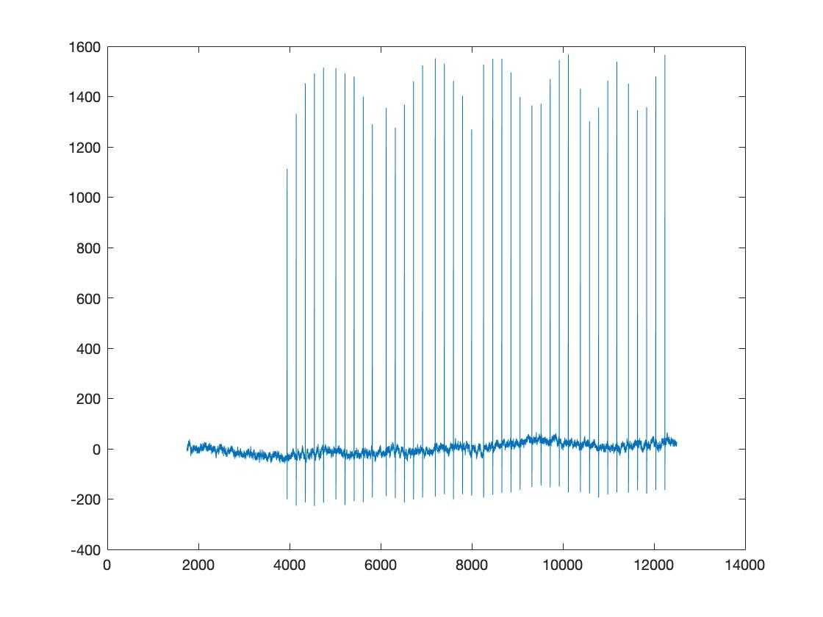
Step 2: Organize the data
The following plot (output Figure 2) gives the part of channel selected. In our example, dt=0.05ms and 35e3:250e3 means 1750ms: 12500ms.

Slide 7
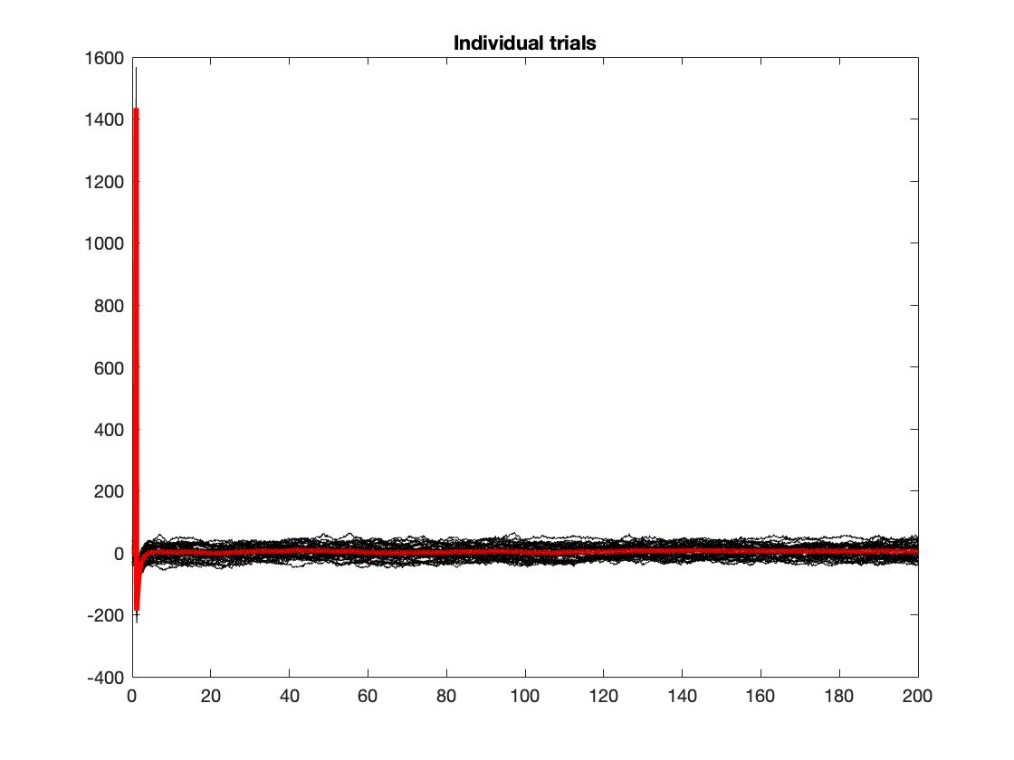
Step 2: Organize the data
The result of the above processing is shown in Figure 3. Note that the thick red line is the average of all individual artifacts.

Slide 8
Step 2: Organize the data
(2). For each individual trial, select the sub-segment “starting from its minimum to end”.
See the picture on the previous slide. The purpose of this sub-step is to ignore the huge part of artifacts (above x-axis) and consider the smaller ones (below x-axis). We select the sub-segment and flip it w.r.t. the x-axis (i.e. take the negative). Then normalize it.
In line 9 choose Nor =0 if you don’t want normalized output but want the original scale.
The corresponding code and output (Figure 4) are shown on the next slide.

Slide 9
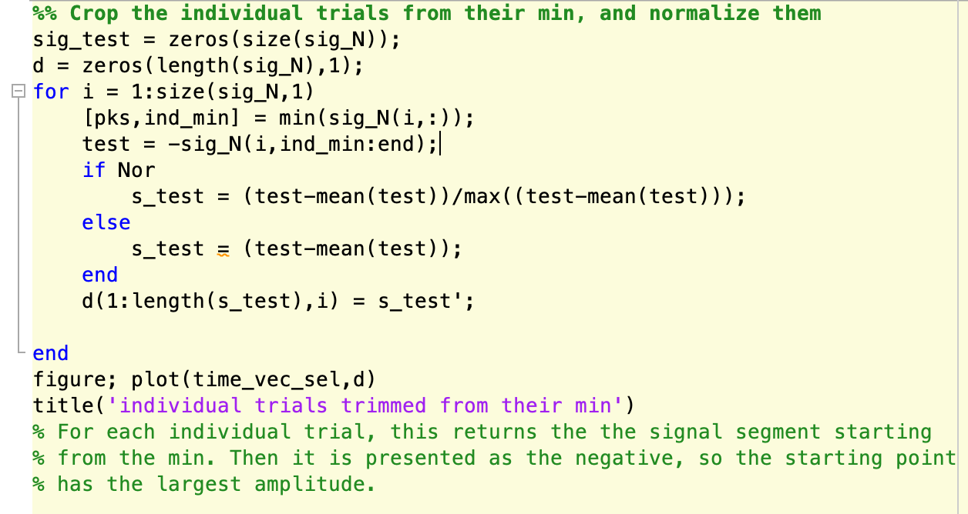
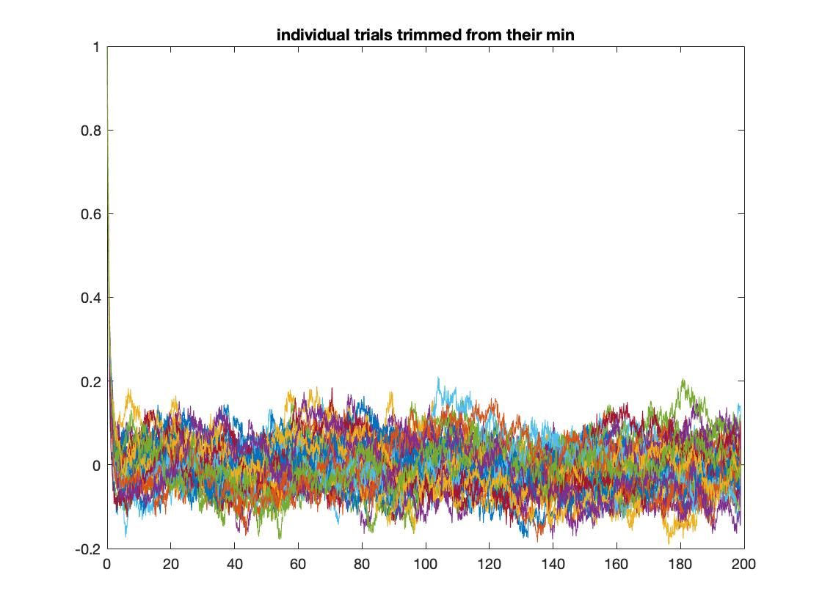
Step 2: Organize the data

Slide 10
Step 3: Fit spline to the artifact part of mean trials
In line 71, the variable “L_seg_ms = 10” means that we select 10ms from the starting point of each individual trial (after Step 2 processing) as the segment that contains the artifact. We then fit the spline to the mean artifacts.
After 10ms, no spline is fit. And the rest of each trial is set to 0.
The part of coding and the corresponding output (Figure 5) are shown on the next slide.

Slide 11
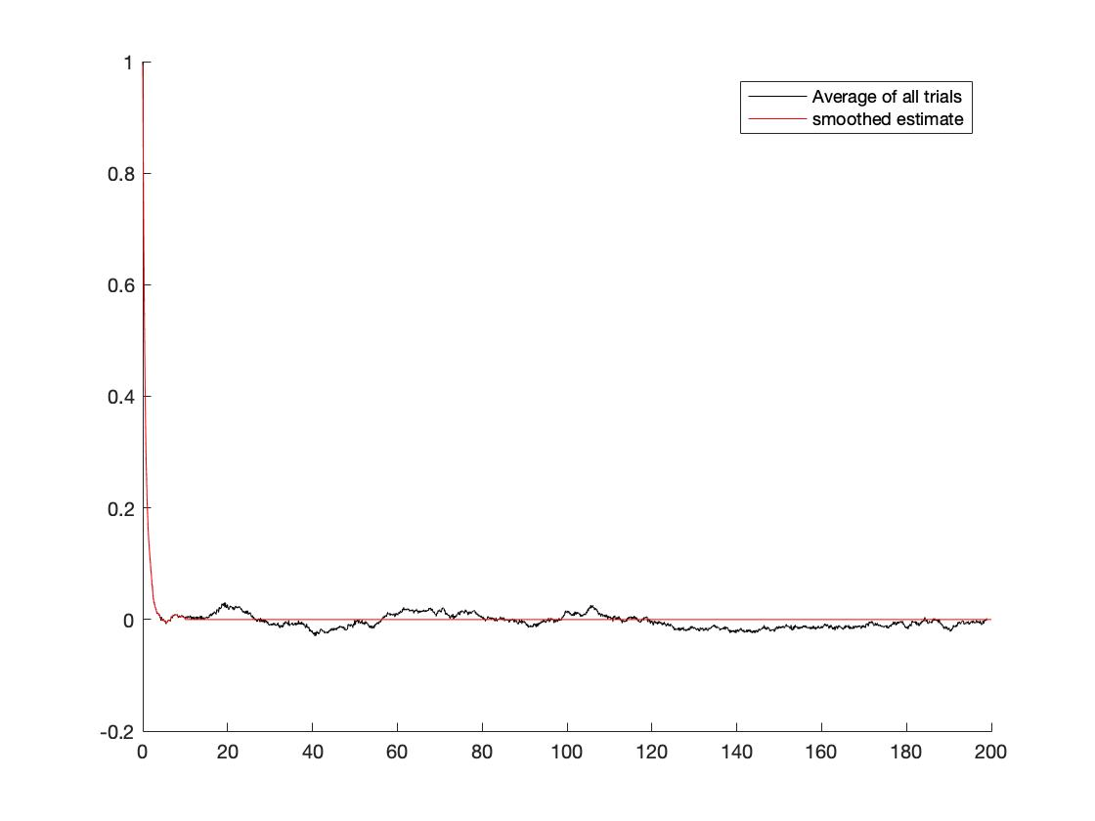
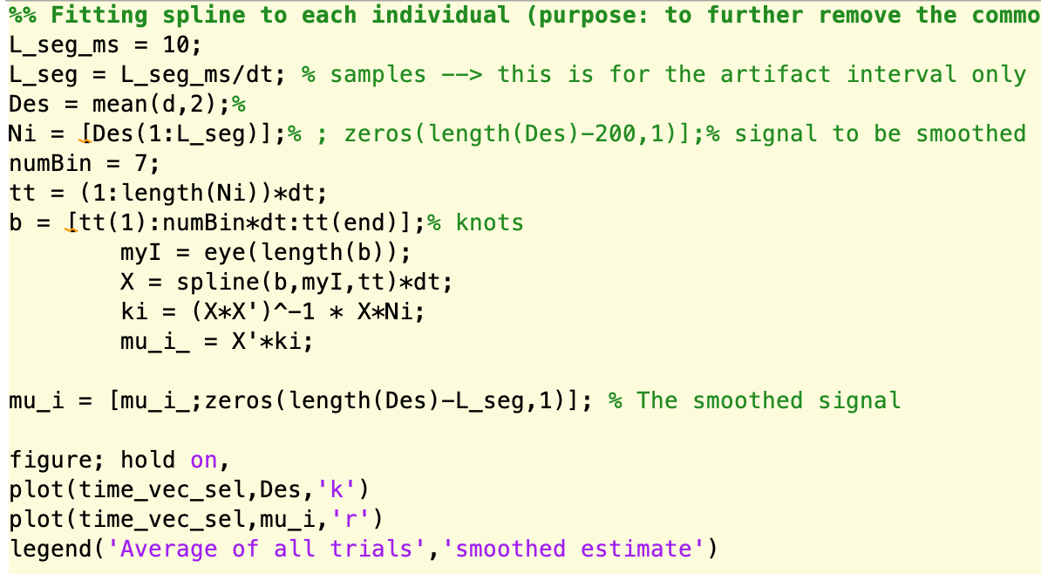
Step 3: Fit spline to the artifact part of mean trials

Slide 12
Step 4: Adaptive filtering to each individual trial
In this step, we use LMS (Least Mean Square) to find the adaptive fit of each individual artifact based on the spline fit to the mean artifacts.
Then for each individual trial, the fitted artifact is subtracted and we obtain a “reconstructed signal”.
The part of coding and the corresponding output of one trial (Figure 6) are shown on the following slides.
Figure 6 gives both the reconstructed signal and the original signal. Figure 7 only gives the reconstructed signal.
We are working on Step 3&4 to make the artifact models more precise.

Slide 13
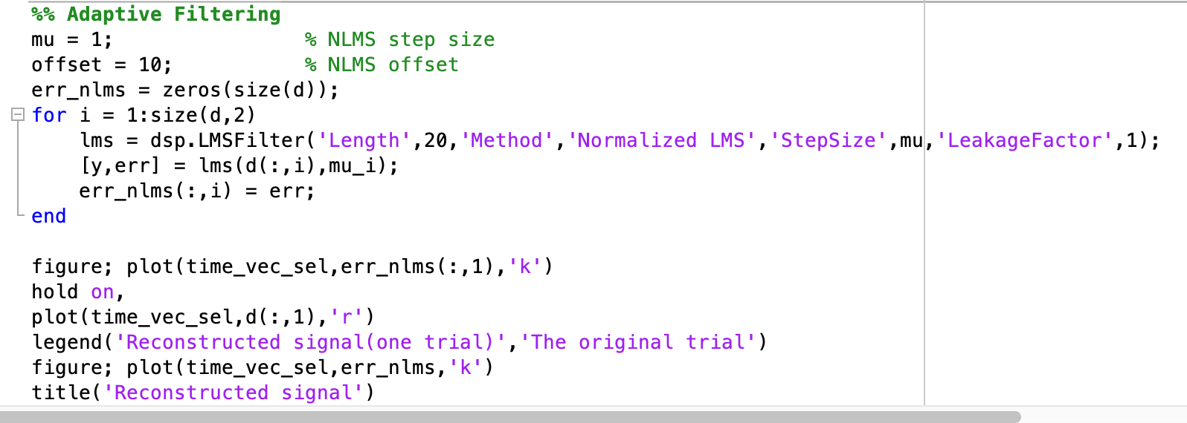
Step 4: Adaptive filtering to each individual trial
The coding:

Slide 14
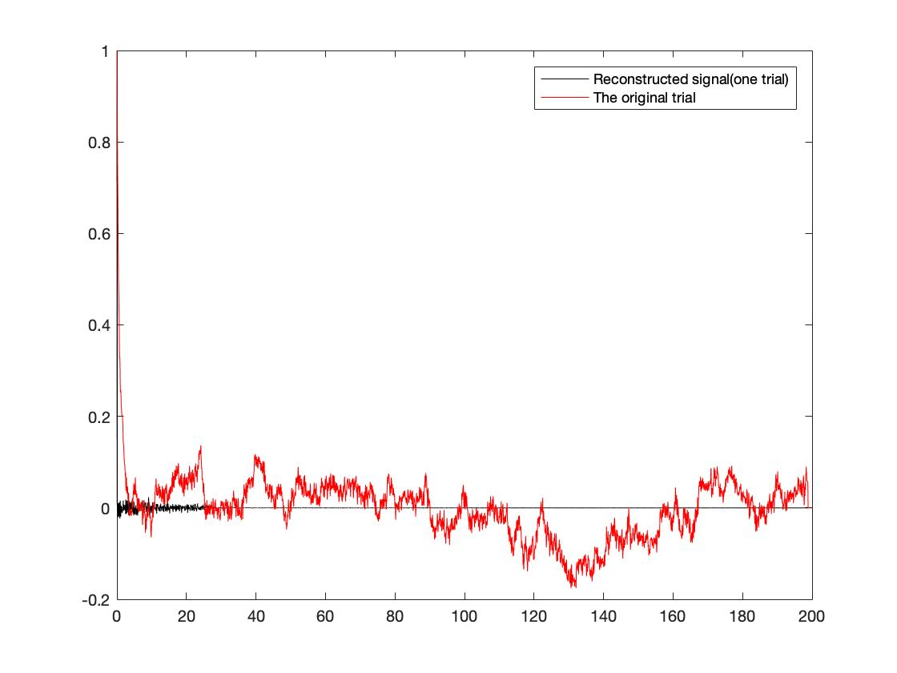
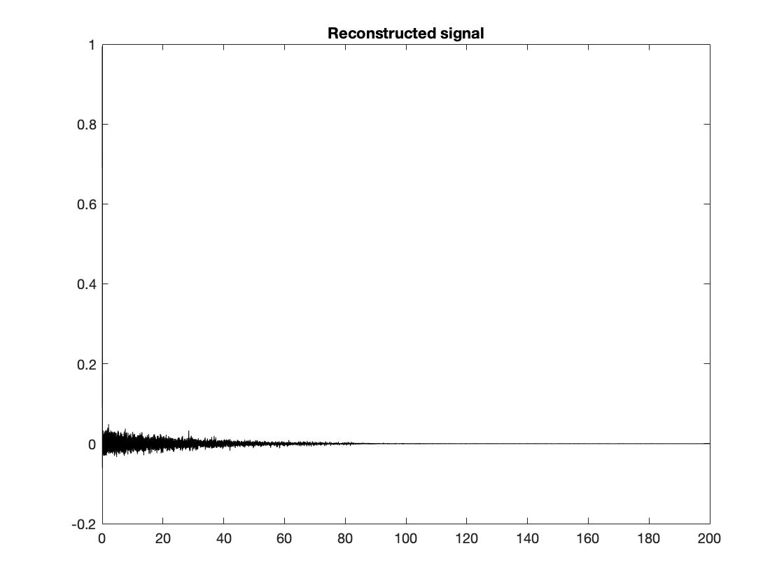
Step 4: Adaptive filtering to each individual trial
Figure 6 on the left; Figure 7 on the right:
Note: The first 1 msec might be contaminated by artifact
Reconstructed part
Consider the data as it is (no need for adaptive filtering)
Important to be considered
Converging to zero meaning that you can consider the recorded data

Slide 15
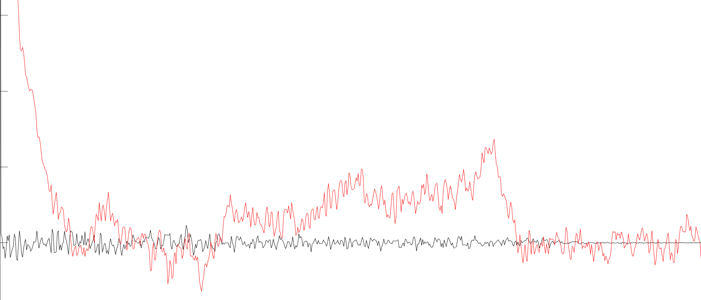
Step 4: Adaptive filtering to each individual trial
Local zoom in of the adaptive filtering result:
Note: The first 1 msec might be contaminated by artifact
Use the recorded LFP or EEG (red), no need for recovery
Reconstructed part (only higher frequency components including beta frequency)

